Slide 1
Omnitags Web Template System
Khenjy Johnelson
Notes:
Teaching a web template engine that is unfamiliar to most people can be challenging, especially if the instructor is already very comfortable with it.
### Example Outline for a Teaching Session
1. *Introduction to Template Engines*
- What is a template engine?
- Benefits of using a template engine
2. *Getting Started*
- Installation and setup
- Basic syntax and structure
3. *Core Features*
- Variables and expressions
- Loops and conditionals
4. *Advanced Topics*
- Partial templates and includes
- Template inheritance
5. *Practical Application*
- Building a simple web page
- Integrating with a backend
6. *Hands-On Workshop*
- Live coding session
- Interactive exercises
7. *Q&A and Discussion*
- Addressing common issues
- Sharing tips and best practices
By following these strategies, you can effectively teach a web template engine, even if it is unfamiliar to most of your audience. The key is to break down the learning process, provide ample practice opportunities, and relate new concepts to familiar ones.
Here are some strategies to effectively teach such a tool:
### 1. *Start with the Basics*
- *Introduction*: Begin with a clear explanation of what a template engine is and why it is useful.
- *Use Cases*: Provide real-world examples where the template engine simplifies tasks.
### 2. *Break Down the Learning Process*
- *Basic Syntax and Concepts*: Start with the basic syntax and fundamental concepts. Use simple examples to illustrate each concept.
- *Progressive Complexity*: Gradually introduce more complex features and scenarios.
### 3. *Use Visual Aids*
- *Diagrams and Flowcharts*: Use diagrams to explain how the template engine processes data and generates HTML.
- *Code Snippets*: Show side-by-side comparisons of code before and after applying the template engine.
### 4. *Hands-On Practice*
- *Live Coding*: Demonstrate coding live to show the process in real-time.
- *Interactive Exercises*: Provide exercises for students to practice what they’ve learned. Use pair programming to encourage collaboration.
### 5. *Provide Clear Documentation*
- *Cheat Sheets*: Create cheat sheets with common syntax and commands.
- *Step-by-Step Guides*: Offer detailed guides that walk through the process of setting up and using the template engine.
### 6. *Encourage Questions and Discussions*
- *Q&A Sessions*: Allow time for students to ask questions and discuss challenges.
- *Discussion Forums*: Use forums or chat groups to facilitate ongoing discussion and support.
### 7. *Relate to Known Concepts*
- *Analogies and Comparisons*: Relate the template engine to concepts students already know (e.g., comparing it to other template engines or programming paradigms).
### 8. *Real-World Projects*
- *Project-Based Learning*: Assign projects that require students to use the template engine to solve problems.
- *Incremental Projects*: Break projects into smaller, manageable tasks that build on each other.
### 9. *Feedback and Iteration*
- *Regular Feedback*: Provide regular feedback on assignments and projects.
- *Iterate and Improve*: Use feedback to improve the teaching approach and materials.
### 10. *Showcase Benefits*
- *Performance and Efficiency*: Demonstrate how the template engine improves performance and development efficiency.
- *Case Studies*: Share case studies or testimonials from companies or projects that have successfully used the template engine.

Slide 2
Outline
Part 1 : Preface
Part 2 : Introduction to web template
Part 3 : Getting Started
Part 4 : Core Features
Part 5 : Advanced Topics
Part 6 : Practical Application
Part 7 : Hands-On Workshop
Part 8 : Q&A and Discussion

Slide 3
Hands-On Workshop
Live coding session
Interactive exercises
Notes:
6. *Hands-On Workshop*
- Live coding session
- Interactive exercises

Slide 4
Live coding session
Preparation

Slide 5
Preparation
Prepare the apps necessary such as:
XAMPP/Laragon
Chrome
VSCODE

Slide 6
Interactive Exercises
Interctive exercises
Cheat sheets

Slide 7

Interactive Exercises
Buatlah sebuah website client-server tentang Pengaduan Masyarakat. Fungsi-fungsi dalam aplikasi:
Registrasi
Menulis Laporan Pengaduan
Verifikasi dan Validasi
Memberikan Tanggapan
Generate Laporan

Slide 8
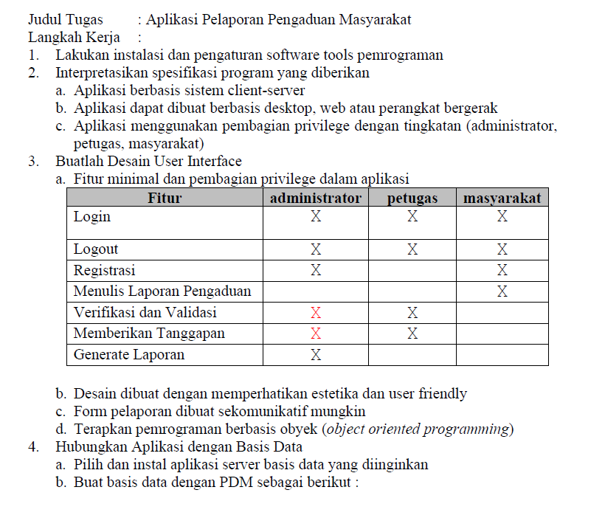
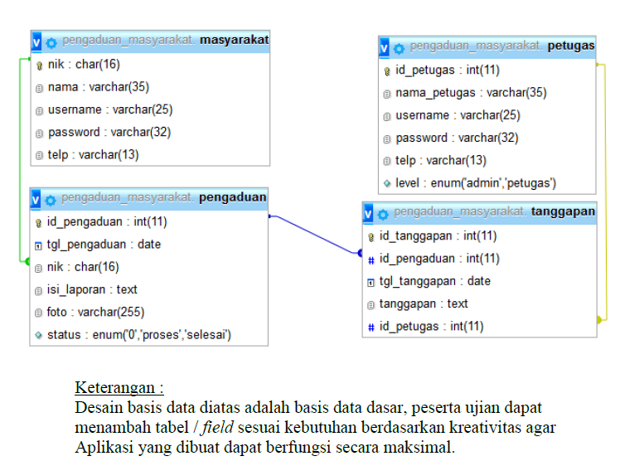
Interactive Exercises

Slide 9
Some Cheat Sheets
Use lots of search feature in vscode (Ctrl+Shift+f) to find the variables and change the contents of the project. Here’s some stuffs to search and replace:
school_ukk_hotel : change it into the database name you use
localhost/me/hotel : change it to where you put your project
Most UI UX components are organized, use helpers if you want to modify the properties of each (DIY: Don’t repeat yourself)

Slide 10
References
https://web.archive.org/web/20121204081204/http://www.phpwact.org/pattern/template_view
https://learning.postman.com/docs/sending-requests/variables/variables/
https://community.postman.com/t/how-to-set-and-get-dynamic-environmental-variable/7482

Slide 11
More here
Discuss
Ask Questions
Collab
Discord:
https://discord.gg/4pTNSCQbvw

Slide 12
Thank You
khenjyjohnelson123@uvers.ac.id

